Slide 1

Actuator profiles
19 May 2017
Joe Brule -- NSA

Slide 2
Agenda
Purpose/ Motivation
Observations
Outline
Status of Actuator Profiles
Potential Actuator Profiles
Proposed Way Forward

Slide 3

OpenC2 as a Concept

Slide 4

At the Language Description Level

Slide 5
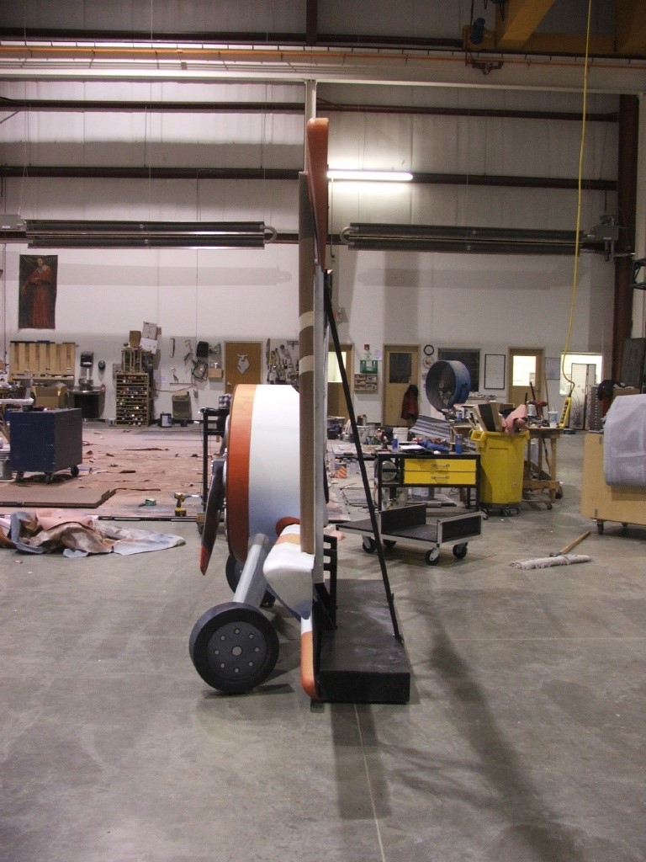
OpenC2 at the Actuator Profile Level

Slide 6
Observations
Actuator profiles are the mechanism by which industry-specific knowledge is incorporated into the OpenC2 standard
Industry participation will enable success
Industry collaboration will define the distinction between the standard and product differentiators
Actuators should be defined by capabilities
‘Hardware’ based approach is redundant and does not support NFV
Multiple ‘profiles’ may be required
‘Universal’ profile?

Slide 7
Actuator Profile Outline
Section One: Introduction
Purpose/ Scope
Applicability
Section Two: Language Binding
Minimum to Implement and Optional Actions
Responses
Data Modeling
Section Three: Command Summary
Description of each action in context
JSON encoded commands for each action
Appendix A: Abstract Schema
Use cases provided in a separate repository

Slide 8
Status of Actuator Profiles
Firewall Profile
Introduction and MTI sections complete
Data Modeling in process
SDN Profile Rework
Draft based on earlier work performed by SPAWAR
Router Profile
Industry to provide initial draft

Slide 9
Potential Actuator Profiles
Actuator –Capability | Description | Notes/ Derived from
External-notification | Machine to human notifications to supports use cases that require human in the loop or human on the loop. | Email, Ticketing, SMS, SIEM
Privilege-management | Manage level of access to system, devices, files etc. to support mitigation of compromised users and/or device use cases | Directory service, Network access controls, compute-platform
DAR-analytics | Task analytic engines to evaluate data at rest such as configuration files, tables, servers etc. to support data enrichment use cases | Forensic, informative, investigative, reputation, threat intel, malware-detection, malware-analysis, vulnerability-scanning
DIT-analytics | Task analytic engines to evaluate data in transit to support data enrichment use cases | Threat Intel, Investigative, traffic-characterization, network-characterization, traffic-capture, intrusion-detection, content-inspection
Router | Manage layer 2 frame switching and layer 3 packet routing functions | We may wish to combine router and SDN ?
Isolation | Create an isolated environment | sandbox, virtualization
Configuration | Query and/or modify the configuration of assets. Used in data enrichment and isolation use cases | NOTE; OpenC2 is not intended to replace pre-existing protocols such as SNMP, but a CM capability is needed for adequate response. Compute-platform
Firewall | First generation packet filter | Packet-filtering, firewall
Application-proxy |  | content-filtering, content-routing

Slide 10
Proposed Way Forward
Refine/ Prioritize List of Actuator Profiles
Identify Editors/ working groups
Feedback loops
Prototype Implementors
Language Description Document
Management
Repository/ version control

Slide 11
Questions? Comments? Complaints?

